Slide 1
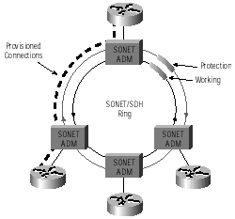
SONET and B-ISDN

Slide 2
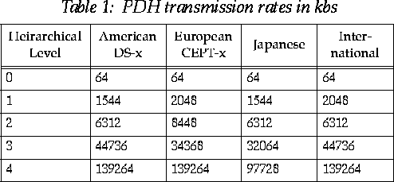
Why SONET ?
  Note the various differences and hence the standardization problem

Slide 3
SONET (Synchronous Optical Network)
Originally developed by Bellcore
  To provide standard optical transmission medium for interoffice trunks
  Right place at right time for B-ISDN
    Fiber based transmission scheme for ATM
Advantages
  Recent
    Permits interoperation of equipment from various manufacturers
  Elegant architecture
    Simplifies standard process

Slide 4
    Taking advantage of LSI and software
      Can supply 155.52 mbps interface
      Has base rate of 51.84mbps
        STS-1 / OC-1
SONET may be transported by
  Electrical
  optical
STS-1/OC-1
  Basic module
  Synchronous Transport Signal – Level 1
  9 rows of 90 columns of 8-bits frame structure
  Information + Overhead ➔ 51.84Mbps➔ STS-1
  Information ➔ 49.536Mbps
  8000 frames/sec ➔ 125μsec/frame

Slide 5
Optical Signal Standard (OSI Level 1)
  Optical Carrier - N (OC-N).
  Used on Fiber.
Electrical Standard (OSI Level 2)
  Synchronous Transport Signal - N (STS-N)
  Used internally in SONET hardware
  STS-N signal is converted to OC-N signal at transmitter laser
Current technology requires optical-to-electrical (O-E-O) conversions at switches, hence STS protocol.

Slide 6
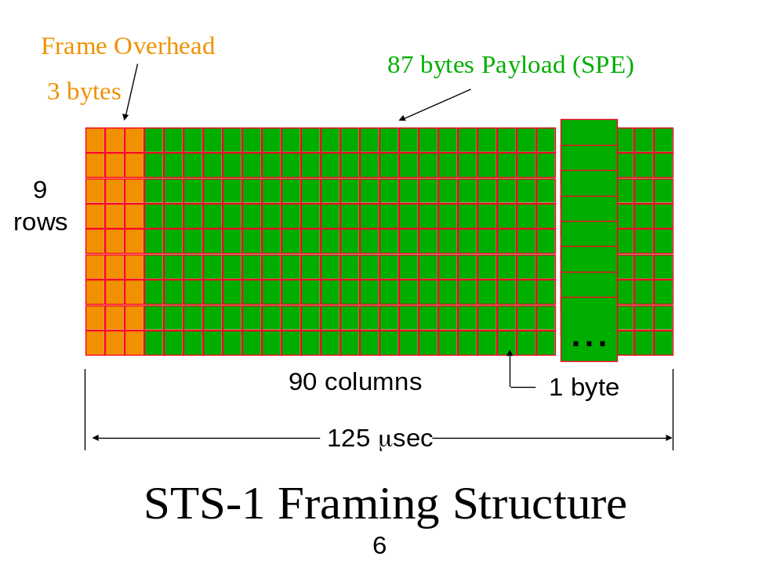
User Data

Slide 7
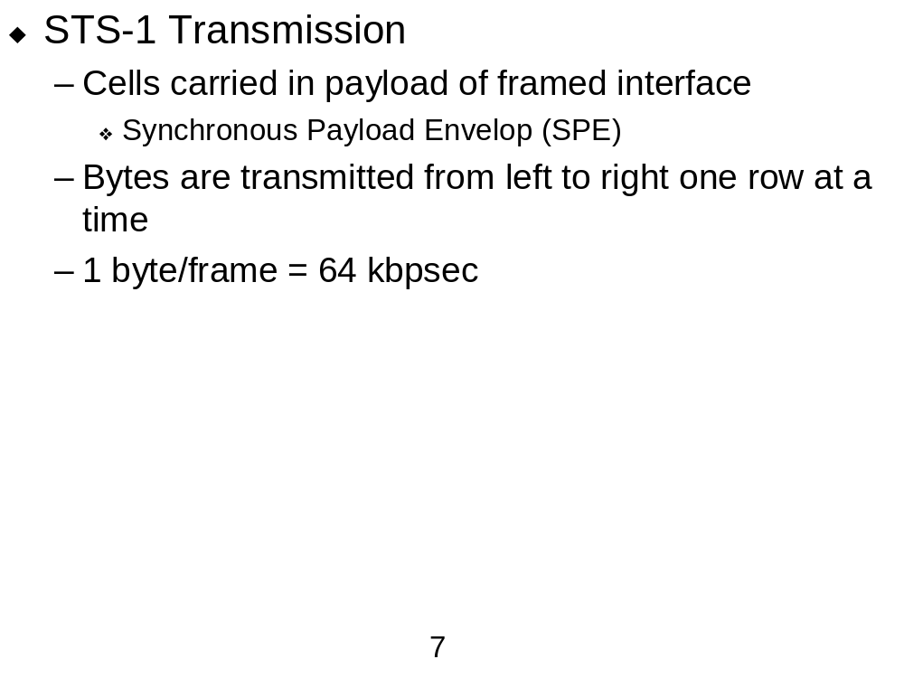
Analog Signal
Sampled signal
Quantized signal
8000 samples/sec
BW = 4kHz
8bits/sample
➔ 8x8000=64kbpsec

Slide 8

T1-system
8 bit words
125μsec
1 2 3 24
24 x 8 x 8000 = 1.544bps

Slide 9
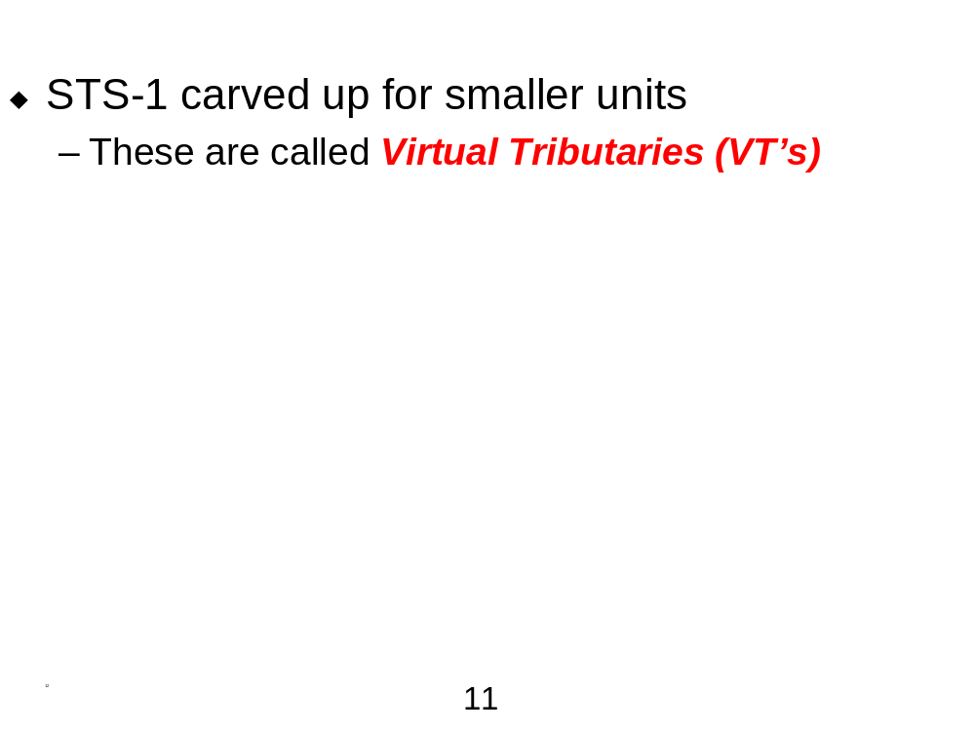
  VT 1.5: requires 3 columns of 9 bytes each, corresponding to North American DS1 (T1) standard (1.544 Mbps)
  VT 2: 4 columns, corresponds to European standard for 2.048 Mbps
  VT 3: 6 columns (54 bytes) per frame, corresponds to 3.088 Mbps
  VT 6: 12 columns, 6.312 Mbps

Slide 10
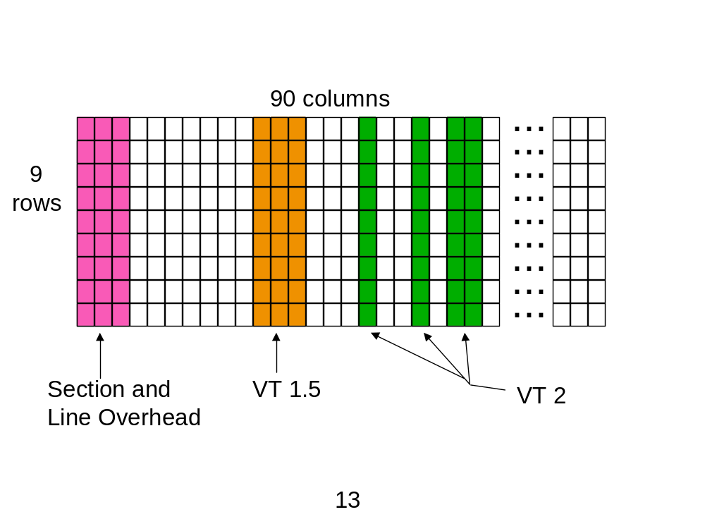

Slide 11
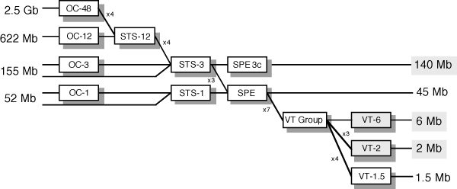
Figure 19. SONET Multiplexing Hierarchy
SONET Multiplexing Hierarchy

Slide 12
STS-N/OC-N
Higher rate SONET signals are obtained by interleaving N STS-1’s to form an STS-N
  e.g., STS-3 = 155 Mbps
STS-N has 9 rows, and N x 90 columns
Interleaving is done byte by byte
Examples:
  OC-1 51.84 Mbps
  OC-3 155.52 Mbps
  OC-12 622.08 Mbps
  OC-48 2.48832 Gbps
  OC-192 9.95328 Gbps
  OC-768 39.81312 Gbps (in the labs & trials)

Slide 13
Synchronous Transport Module (SDM)
STM-1 same as STS-3c
  Single source concatenated
  NOTE:
    STS-3 ➔ 3 STS-1 streams
    STS-3c➔ 1 single STS-3 from one user
STM-n ➔ n times STM-1➔ STS-3n

Slide 14
SONET for ATM
The 53-byte ATM cells are simply packaged into the SPE portion of the STS-1 frame, as they fit
Use STS-1, STS-3, STS-12

Slide 15
SONET Model
4 layers
  Photonic - physical characteristics of the optical equipment
  Section - frame format and electro-optic conversion
  Line - synchronization and multiplexing onto SONET frames
  Path - end to end transport

Slide 16
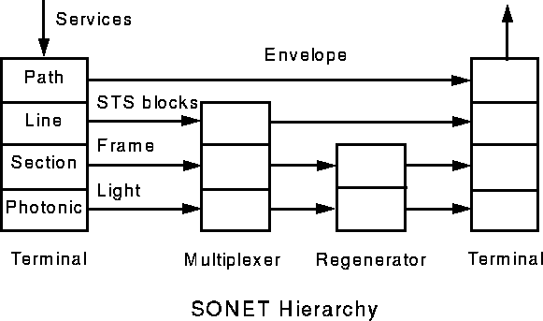

Slide 17
SONET Physical Layer
Path
  Path signal Identification
Line
  Multiplexing
  Synchronization
Section
  Bit Timing
  Coding
Photonic
  Physical properties of light and fiber to be used
Framing
Scrambling
Error Monitoring

Slide 18
Repeater
Source
MUX
Fiber
Path Terminating Equipment
Line Terminating Equipment
Section Terminating Equipment
Dest.
MUX
Path Terminating Equipment
Line Terminating Equipment

Slide 19
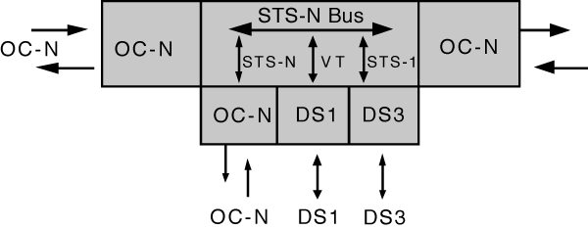
Add/Drop Multiplexer (ADM)
-Network Elements
-May differ in features from vendor to vendor.
    SONET does not restrict manufacturers
      For example, one vendor might offer an add/drop multiplexer with access at DS1 only, whereas another might offer simultaneous access at DS1 and DS3<number> rates

Slide 20
A single-stage multiplexer/demultiplexer
  can multiplex various inputs into an OC-N
  At an add/drop site, only those signals that need to be accessed are dropped or inserted.
  The remaining traffic continues through the network element without requiring special pass-through units or other signal processing.

Slide 21
SONET ADMs
Combination of
  Multiplexer
  Protocol converter
Needed for
  Ethernet (LAN Gateway)
  Token Ring (LAN Gateway)
  ISDN primary access
  MAN
  HDTV
  FDDI

Slide 22
Transmitting ADM
  inserts (adds) the traffic into a TDM time slot
Receiving ADM
  removes (drops) the traffic from the ring and forwards it to the receiving router
  Signal may pass through by intermediate ADMs on the ring

Slide 23
Self-Healing Ring Architectures
B_ISDN
  handles a large amount of information
  a network failure will paralyze social and business activities.
SONET
  is the most suitable technology for satisfying these demands
  has an advanced operation and maintenance (OAM) function.

Slide 24
Linear ADM
Service may originate or terminate on any node in chain
Terminal
ADM
ADM
Terminal
fiber

Slide 25
Ring ADM
.
The SONET building block for a ring architecture is the ADM.
Multiple ADMs can be put into a ring configuration for
  either bidirectional or
  unidirectional traffic
Advantage of Ring Topology
  its survivability
    if a fiber cable is cut, the multiplexers have the intelligence to send the services affected via an alternate path through the ring without interruption

Slide 26
Self-Healing Ring Architectures
B_ISDN
  handles a large amount of information
  a network failure will paralyze social and business activities.
SONET
  is the most suitable technology for satisfying these demands
  has an advanced operation and maintenance (OAM) function.

Slide 27
A self Healing Ring (SHR)
  Has excellent survivability characteristics
  consists of add-drop multiplexers (ADM's),
  guards against fiber cuts
  generally be divided into two
    bidirectional SHR's (B-SHR's)
    unidirectional SHR's (U-SHR's).

Slide 28
Bidirectional SHR (B-SHR)
  both directions of a duplex channel travel over the same path
  requires two working fibers to carry a duplex channel
  requires two protection fibers to carry a duplex channel
unidirectional SHR (U-SHR)
  the direction of a duplex channel travel the opposite paths
  requires only one working fiber to carry a duplex channel
  requires only one protection fiber to carry a duplex channel

Slide 29
working
A
Protection
D
B
A
C
D
B
Bidirectional SHR with 4 fibers
C
Unidirectional SHR

Slide 30
working
A
D
B
Uses working fibers with spare capacity for protection
C
Bidirectional SHR with 2 fibers

Slide 31
Self healing control schemes
Line protection switching
Path protection switching
Line Protection
  Uses SONET line overhead
  Restores line demand from a failed facility
Path Protection
  Uses SONET path overhead
  Restores individual end-to-end service channel

Slide 32
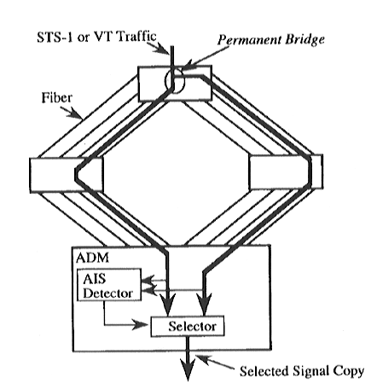
U-SHR
Two copies of signal are sent around the ring
  In opposite directions
  Destination selects the better one

Slide 33
B-SHR/2
Capacity in each fiber is divided in to two
  Working traffic
  Protection traffic
Normal operation
  Use only the working capacity
During failure
  Protection capacity is used
APS (Automatic Protection Switching)
  Triggers a protection switching
    RING SWITCHED

Slide 34
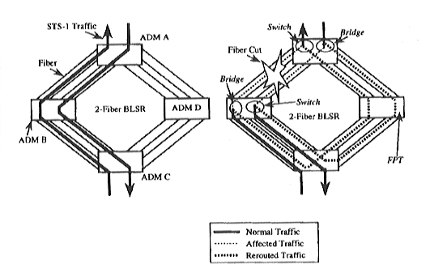

Slide 35
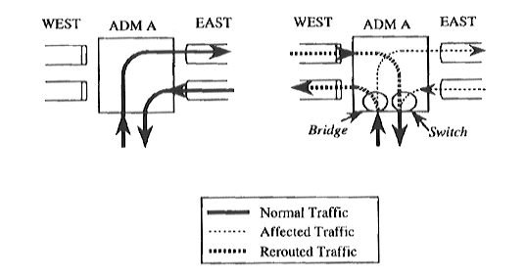
Details of ADM operation in B-SHR/2

Slide 36
B-SHR/4
Working and protection traffic travel on separate fibers
Equipped with
  Ring switch
  Span switch
Failure Types
  Only working fiber fails
    Switch traffic from a failed fiber to a protection fiber on the same span
    “span switch” state

Slide 37
Failure type (contd.)
  When both working and protection fibers fail
    Ring switch is triggered
    Reroute traffic in the opposite direction

Slide 38
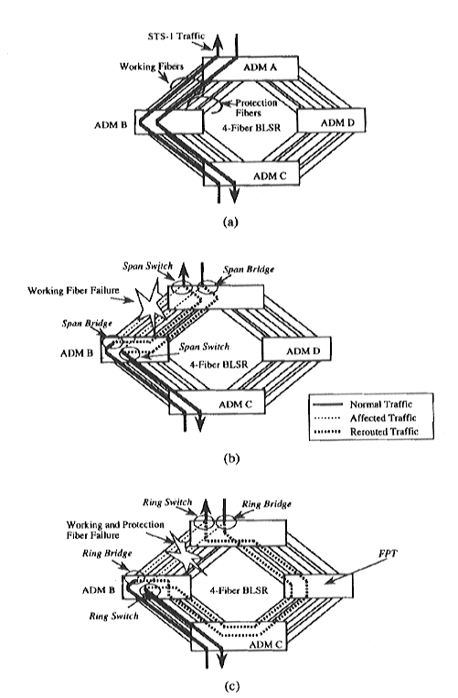

Slide 39
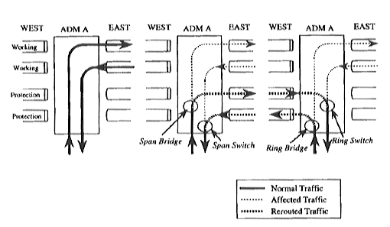

Slide 40
SUMMARY
SONET provides
  Robust
  Survivable architecture
  requires the provisioning of a point-to-point circuit between the devices that need to communicate
  operations, administration and maintenance capabilities
  offers rates of data transmission from 51.84 Mbps to 48 Gbps.

Slide 41
different protection schemes with different levels of complexity protection level:
  Unidirectional path-switched rings (UPSRs)
  Two-fiber bidirectional-line switched rings (BLSR2s)
  Four-fiber bidirectional-line switched rings (BLSR4s)
Today commercially available in USA
  unidirectional rings with path protection switching and
  bidirectional with line protection switching

